Slide 1
Face Recognition with Tensorflow and Face Recognition library- jsTensorflow
Phy Lieng
Supervisor: Nhan Cao

Slide 2
MOTIVATION
There has been a rise in objection detection and recognition. According to Andrew Ng, formerly head of Google Brain, machine learning has a ton of day-to-day life applications [1].
According to Jared Bennett, Center for Public Integrity, there are 2 billion monthly users who upload 350 million photos every day on Facebook which provides the company an infinite sources of face dataset[2].
[1] https://www.coursera.org/learn/machine-learning
[2] https://www.thedailybeast.com/how-facebook-fights-to-stop-laws-on-facial-recognition

Slide 3
OBJECTIVES
This research tries several different strategies to have a bigger overview of how each methods affect the result of face recognition.
The goal of this research is to figure out how Tensorflow [1] and OpenFace [2] work on face recognition and their applications.
[1] Tensorflow, https://www.tensorflow.org/
[2] cmusatyalab, OpenFace, https://github.com/cmusatyalab/openface

Slide 4

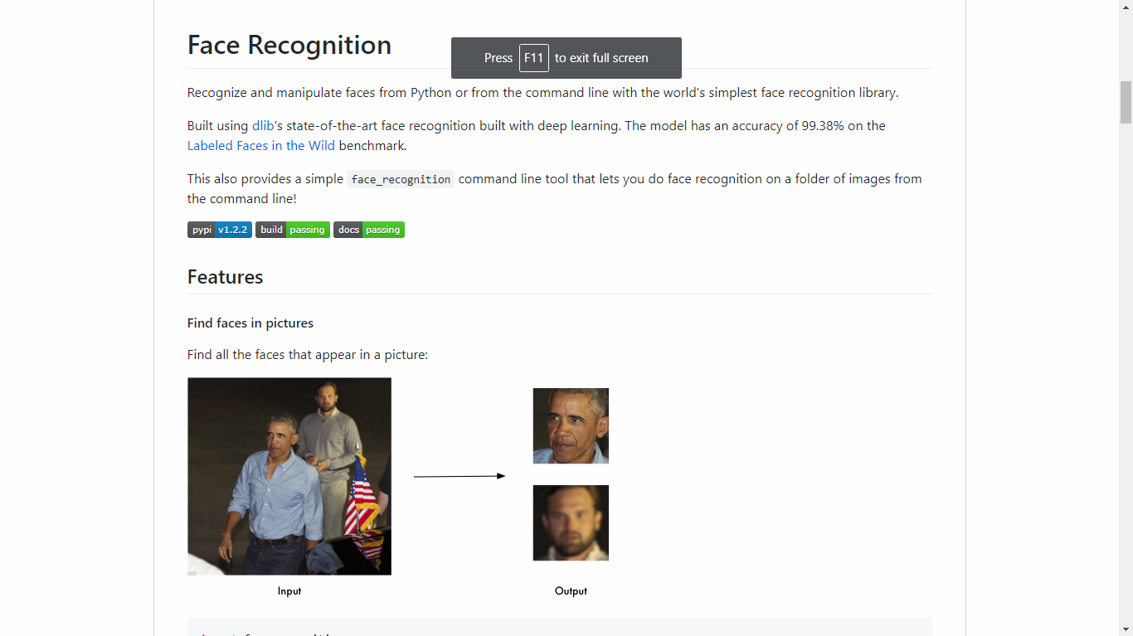
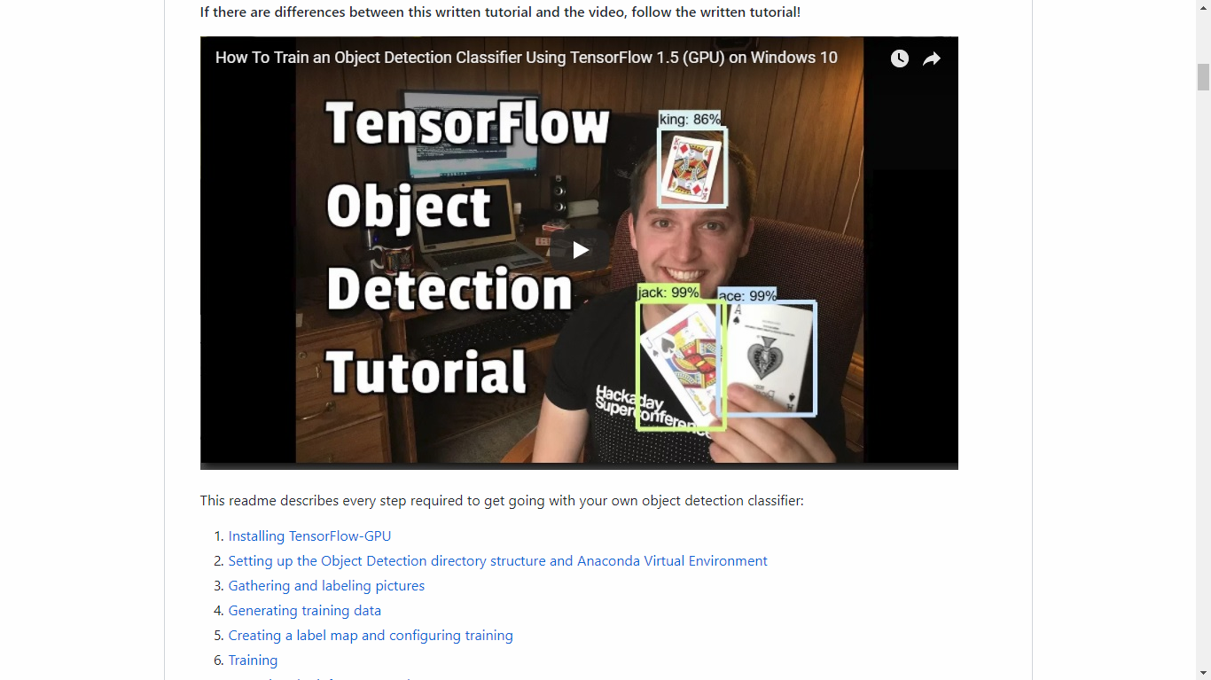
Applications and Related Works
There are some applications using Tensorflow and OpenFace.

Slide 5
Method

Slide 6
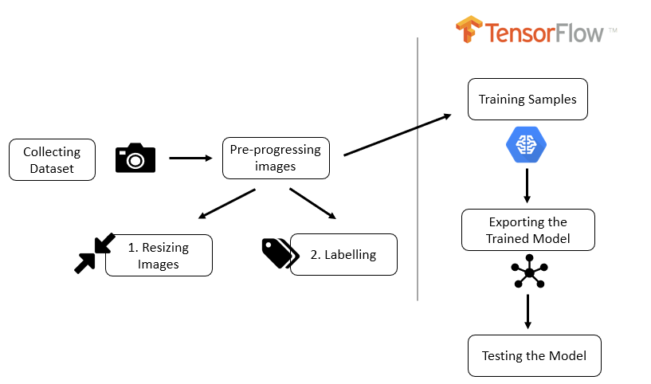
1. Tensorflow Object Detection API
Fig. 1. Training model process

Slide 7
1.1 Object Detection Model
We mainly focus on two recent architectures: Faster-RCNN, and SSD (Single Shot Detector).

Slide 8
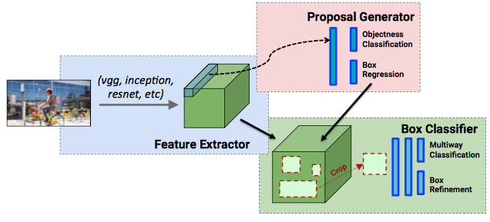
A. Faster RCNN
Fig. 2. Faster RCNN high level diagrams [1]

Slide 9
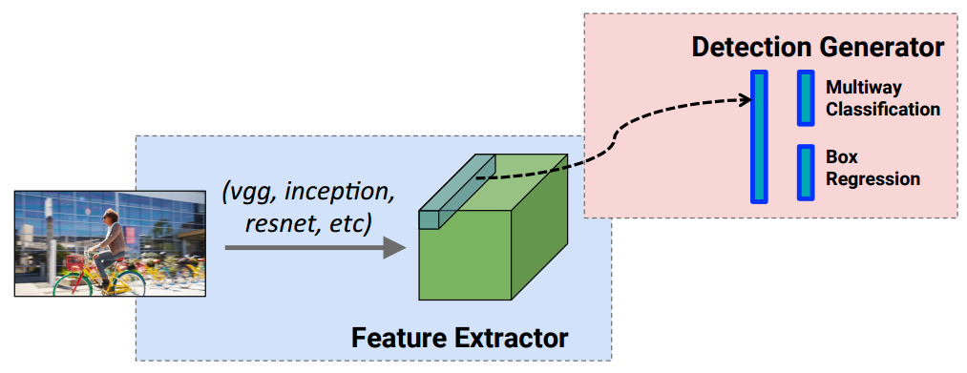
B. SSD
Fig. 3. SSD high level diagrams [1]

Slide 10
1.2 Model Selection
We only consider two potential candidates of COCO-trained models which are Faster_RCNN_Inception_V2 and SSD_MobileNet_V1
We want to deploy the trained model on mobile since SSD-MobileNet offers a faster detection according to a report by Google Research[1].
[1] “Speed/accuracy trade-offs for modern convolutional object detectors”, https://arxiv.org/pdf/1611.10012.pdf

Slide 11
2. Face Recognition with dlib
K-Nearest Neighbors algorithm (KNN) provided by Skikit-learn library and written in Python 3.6 is used to train the data samples
Face Recognition library built using dlib’ state-of-the-art face recognition to get the face encodings of each image.

Slide 12


A. K-Nearest-Neighbors
Fig. 4. Example of k-NN classification [2]

Slide 13
B. Face Recognition
Step 1
Generating a face pattern based on the HOG algorithm, and it find the part of the simplified images that look the most similar to an original known HOG face pattern.
Step 2
The face landmark estimation algorithm will be used to figure out 68 specific points that exists on every face. From the found landmarks, OpenCV ‘s affine transformation will use some basic image transformations like rotation, scale and shear to try to make the eyes and lip always appear in the same location on each image.
Step 3
The centered face images are pass through a deep convolution neural network to obtain 128 measurements of each face which is also known as an embedding.
Step 4
In this final step, any basic machine learning classification algorithm can be applied to learn the all the measurements from step 3.

Slide 14
3. Features Training and Testing
The training dataset consists of 114 samples of 22 classes varying in the number of data samples of each person.
we create and train the KNN classifier with the support of Face Recognition library and dlib.

Slide 15
Experiment

Slide 16
1. Tensorflow Objection Detection

Slide 17
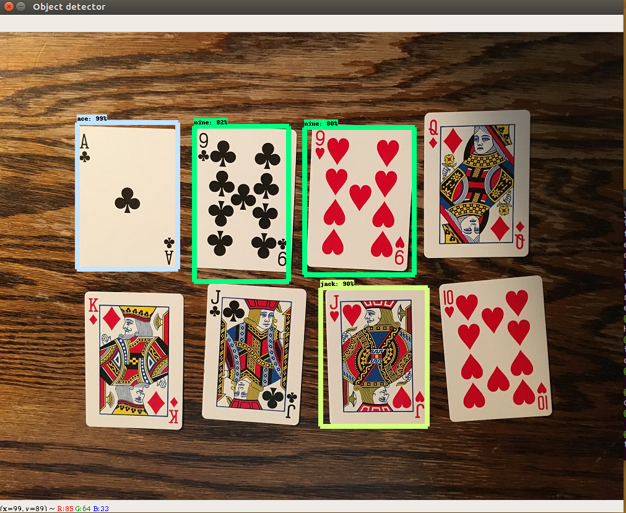
A. Faster_RCNN_Inception_V2
After 5 hours of training on CPU core i5 Ram 8GB, the models can detect three over six classes with a remarkable accuracy as shown in Figure 2.
Fig. 4. “Pinochle Deck” card detector result

Slide 18
B. SSD-MobileNet
About 80 images with 80% train and 20% test on 8 classes and the training is processed on GPU NVIDIA Quadro K2000.
Finally, after nearly 200,00 steps, we fail to recognize any faces even when the images used to detect is from the test or train dataset.

Slide 19
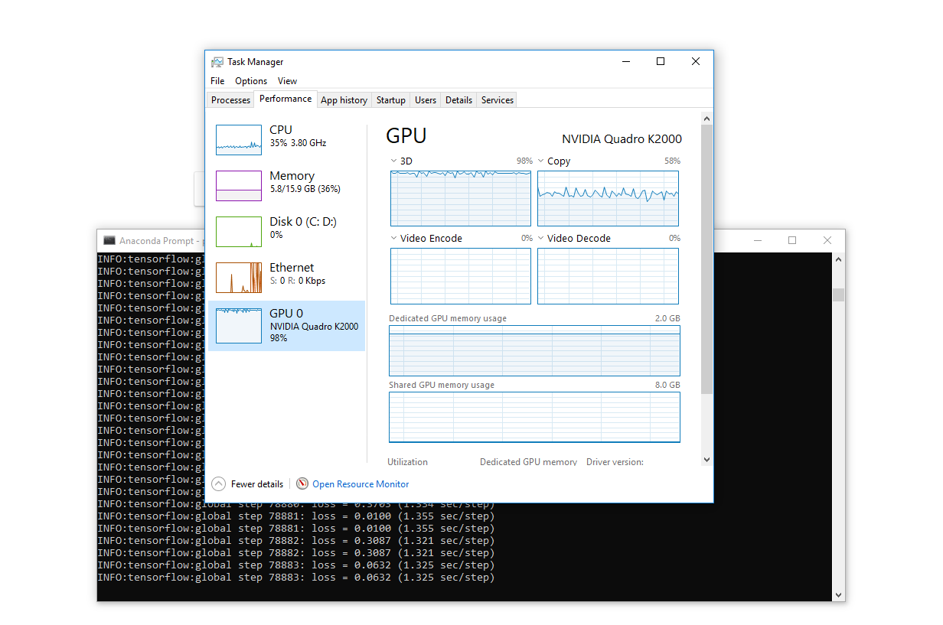
Fig. 5. Training process with 2 classes on NVIDA Quadro K2000
B. SSD-MobileNet

Slide 20
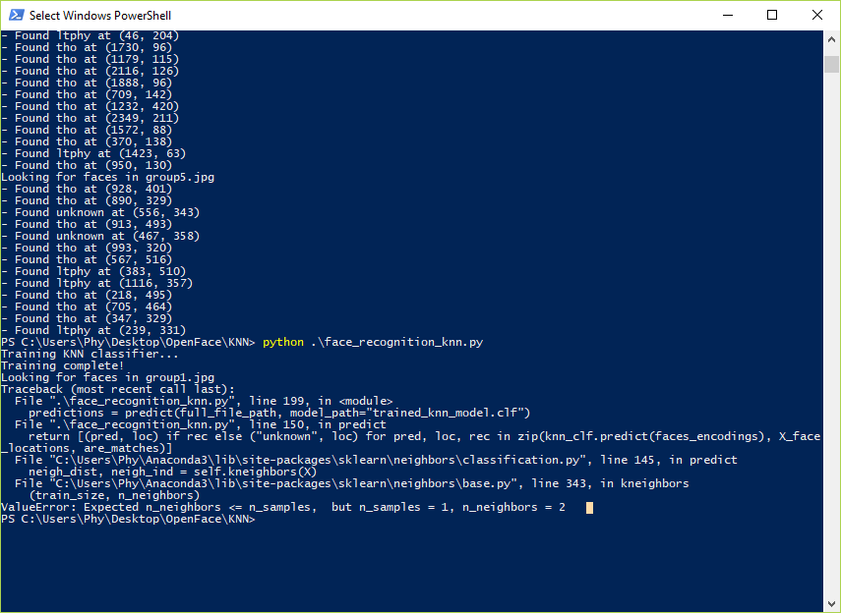
C. Face Recognition and dlib
Fig. 6. Error when training with the original dataset

Slide 21
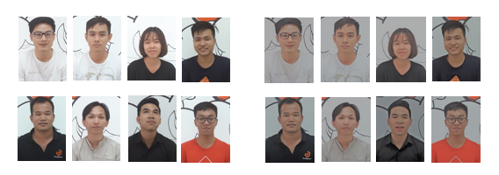
Fig. 7. Before and after adjusting intensity using sauna effect
The filter effect of all previous data samples is changed to Sauna with intensity of 50

Slide 22
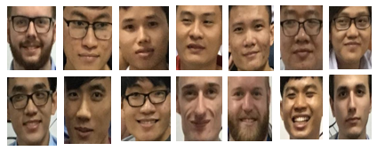
Fig. 8. Additional Dataset
The new dataset is added to become 22 classes

Slide 23
128 measurements of the same person in two different pictures
Thao
[-0.09143673 0.14404117 0.09163638 -0.02201351 -0.08715709 -0.03401219
-0.0430366 -0.13384518 0.13131465 -0.05030623 0.26867479 -0.03836578
-0.139742 -0.2311437 0.02363848 0.158131 -0.18502516 -0.15631089
-0.01550662 0.00155355 0.07154757 -0.03024469 0.09220023 0.00645916
-0.11172537 -0.42903262 -0.08676237 -0.10209452 0.04021091 -0.06111384
-0.10320862 0.07242068 -0.20608672 -0.10182134 0.00876315 0.12982236
-0.01777384 -0.02922249 0.11718373 -0.04690438 -0.17950664 0.05695527
0.04165406 0.26075602 0.20917839 0.03019516 0.07247589 -0.07503243
0.11590367 -0.09681671 0.0375165 0.12816414 0.12421493 0.00070724
0.05166971 -0.09810744 -0.01562024 0.0791115 -0.10496915 0.02843168
0.05477168 -0.06737432 -0.0704393 -0.09545957 0.206122 0.05818361
-0.05933812 -0.19937423 0.1263168 -0.08996605 -0.07500312 0.05025242
-0.21020082 -0.14107323 -0.31195244 0.01075129 0.33314985 0.04324207
-0.2357171 0.03312682 -0.0585367 0.03832621 0.07165226 0.13974266
-0.01043003 0.07238907 -0.18016064 -0.00163909 0.18674836 -0.1005205
-0.02319968 0.2012331 0.00671121 0.08330229 0.02106866 -0.03994822
-0.04798226 0.07180528 -0.18089196 -0.04034073 0.04493449 -0.05625258
-0.0599749 0.10161135 -0.1542625 0.04753869 0.01591582 0.078808
0.01804686 -0.02107707 -0.09109351 -0.12061261 0.10358799 -0.22339086
0.16208722 0.23985972 0.05192013 0.10093542 0.09402268 0.07242928
0.00363198 0.00591673 -0.17234387 0.00612782 0.06963991 -0.02068607
-0.01013132 0.02525742]
Thao
[-0.06842408 0.15490511 0.07935753 -0.02114955 -0.06782446 -0.04844435
-0.02394806 -0.13345227 0.12635387 -0.02896018 0.25738993 -0.04538395
-0.15637574 -0.20366894 0.04334524 0.14813749 -0.17588352 -0.13792995
-0.04293995 0.02855216 0.0771566 -0.02367742 0.09201654 0.0162111
-0.07390113 -0.42547697 -0.10465346 -0.10515051 0.0398408 -0.04091396
-0.10018668 0.08329797 -0.18937133 -0.12055412 0.01485517 0.12138188
-0.01073856 -0.04706927 0.12852144 -0.05936584 -0.19793144 0.07775343
0.04974173 0.25361824 0.19759104 0.02302016 0.084544 -0.07137991
0.09787501 -0.08843695 0.02870219 0.12513429 0.12041804 0.01237038
0.04309297 -0.09371614 -0.00239506 0.07411777 -0.12384939 0.01528573
0.07308366 -0.0805217 -0.07207874 -0.09419626 0.20085202 0.06498762
-0.056566 -0.20265661 0.11251194 -0.09525706 -0.08305004 0.06136887
-0.23196051 -0.13499279 -0.30200446 0.02825952 0.34877235 0.04375416
-0.22318803 0.04682028 -0.05925456 0.0363446 0.07900584 0.14424336
0.00076423 0.0744021 -0.17518064 0.01859006 0.1917254 -0.10669886
-0.03478252 0.18978934 0.0091015 0.08328183 0.01846516 -0.0317982
-0.01752561 0.05996107 -0.19373155 -0.02528007 0.06671905 -0.04607799
-0.06881687 0.09905573 -0.14717101 0.03051257 0.02009618 0.06609663
0.02693595 -0.02486468 -0.08202405 -0.10980833 0.11058485 -0.21496341]
0.16726081 0.22904205 0.03795156 0.07466769 0.07630435 0.07772949
0.00621476 -0.0049522 -0.19359119 -0.00417694 0.10645527 0.01647835
0.00490186 0.0107298 ]

Slide 24
Result Summary
TABLE I
Total Cases = 76 | Predicted No | Predicted Yes
Actual No | 4 | 2
Actual Yes | 0 | 70
True Positive rate | 1
False Positive Rate | 0.333333333
Accuracy | 0.973684211

Slide 25
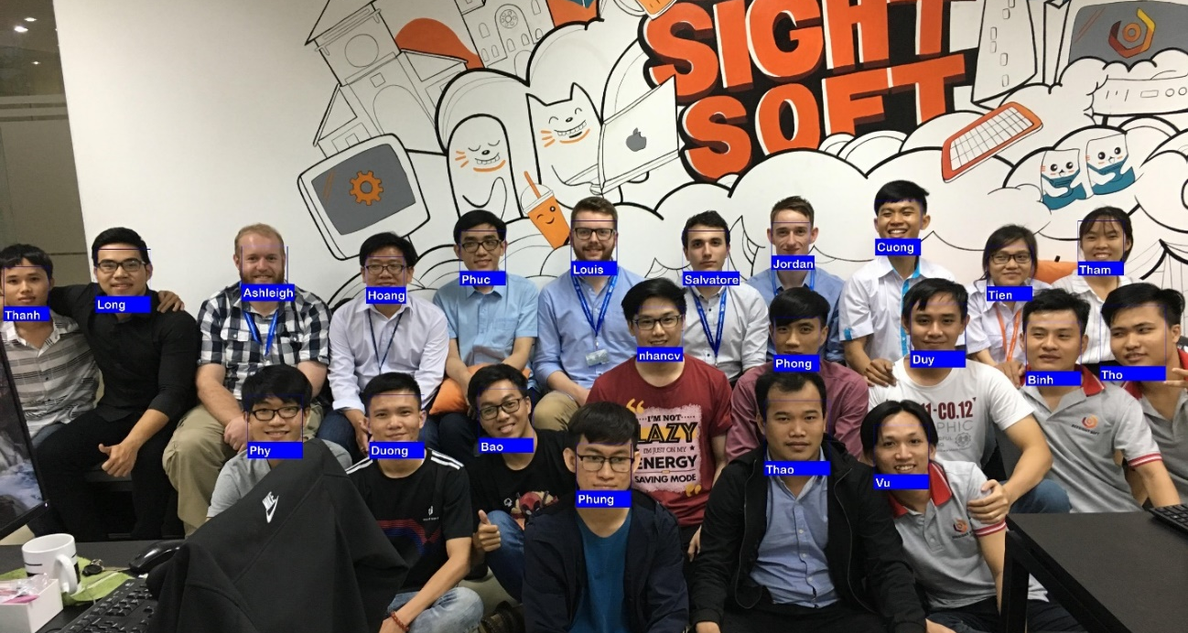
It can recognize 22 classes. Yay!!

Slide 26
Training Method Result Summary
TABLE II
Training method | Result
Tensorflow with 8 classes and 80 samples | Fail
Tensorflow with 2 classes and 500 samples | Fail
Face Regconition with 8 classes and 80 samples | Error
Face Recognition with 22 classes and 114 samples | Success

Slide 27



D. jsTensorflow Game

Slide 28
D. jsTensorflow
TABLE III
COMPARISION BETWEEN PC AND WEBBGL
Socket Platform | Socketio | Simple WebSocket | WebSocketSharp
PC | Supported | Supported | Supported
WebGL | Unsupported | Supported | Unsupported

Slide 29
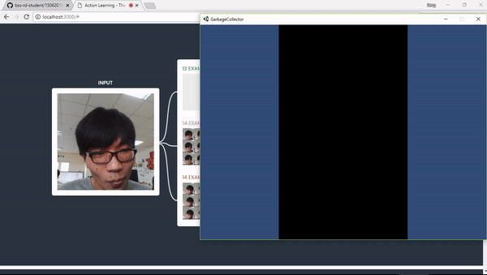
Demo

Slide 30
Conclusion
Using Tensorflow Object Detection API (1) and using Face Recognition library with dlib (2) for face recognition.
The accuracy of the fourth experiment using (2) is above 97% for 114 samples corresponding to 22 classes.

Slide 31
Future Work
We will deploy the current outcome that used the Face Recognition library on Android.
We will test the successful result in a real life context in real-time environment.
Besides, the jsTensorflow project should be developed into different variety of game styles

Slide 32
References
[1] “Speed/accuracy trade-offs for modern convolutional object detectors”, https://arxiv.org/pdf/1611.10012.pdf
[2] https://en.wikipedia.org/wiki/K-nearest_neighbors_algorithm

Slide 33

THANKS FOR WATCHING

